Slide 1
Lecture 6 – IP Subnetting and IPv6 Addressing
COMP1002 (Cybersecurity and Networks)

Slide 2
Overview
Explain the need for subnetting (ch 11)
Calculate addressing for given network and subnet mask
Describe Variable Length Subnet Masking (VLSM)
Design and implement hierarchical addressing
IPv6 addressing (ch 12)
IPv6 business network deployment

Slide 3
Part 1: IP Subnetting

Slide 4
Why subnetting
To provide levels of hierarchy
Flat networking is difficult to manage
E.g. – UoP network – 141.163.0.0/255.255.0.0
All broadcasts would propagate to whole network
Connectivity – stacks of interconnected switches
Implementation: combination of
255.255.255.0 – typical network segments
255.255.255.240, 255.255.255.252 – core routers
Replicate division of location/roles/device types
Communication between subnets requires a router
No difference between network and subnet
Notes:
Switches propagate broadcasts out all interfaces except the interface on which it was received. Only routers do not propagate broadcasts (or routers segment broadcast domains).
Device types: e.g., all hosts, all servers, all printers.
Roles: e.g., students, HR, staff

Slide 5
Subnetting
Creating multiple networks from a single address block
Method “borrow” network bits from the host part
/m network, borrowing n bits
2^n subnets
2^(32-n-m) hosts/subnet

Slide 6
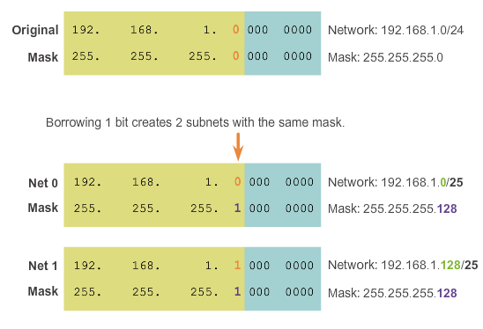
Subnetting examples

Slide 7
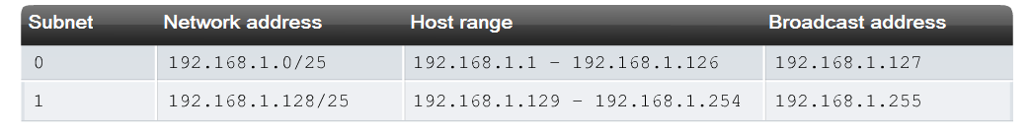
Subnetting examples
Borrow 1 bit – 2 networks

Slide 8
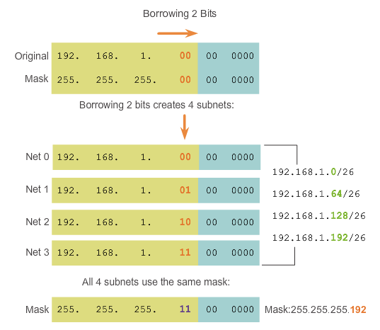
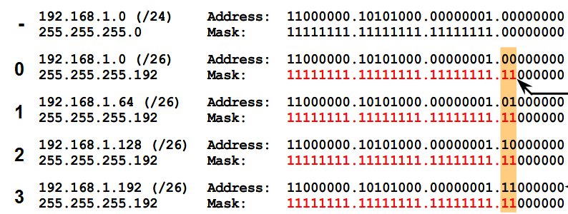
Subnetting examples
Borrow 2 bits –4 subnets, 62 hosts/subnet

Slide 9
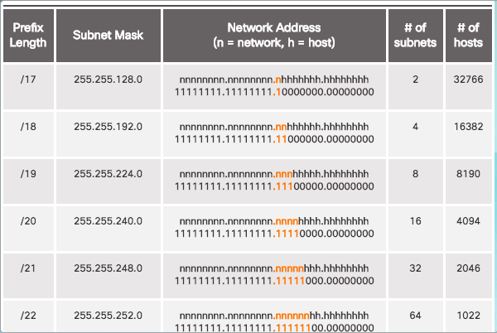
Subnetting examples – subnet a /16 network

Slide 10
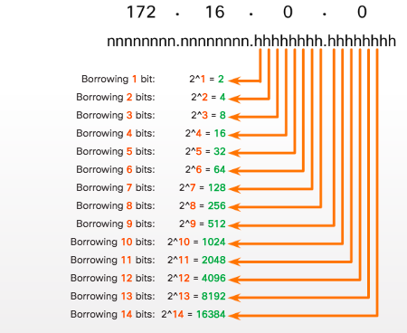
Subnetting examples – subnet a /16 network

Slide 11
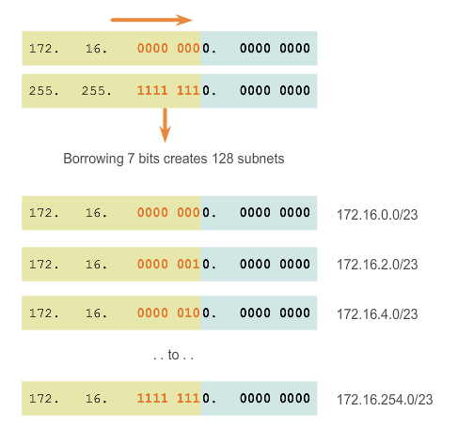
Subnetting examples
Borrow 7 bits – 128 networks

Slide 12
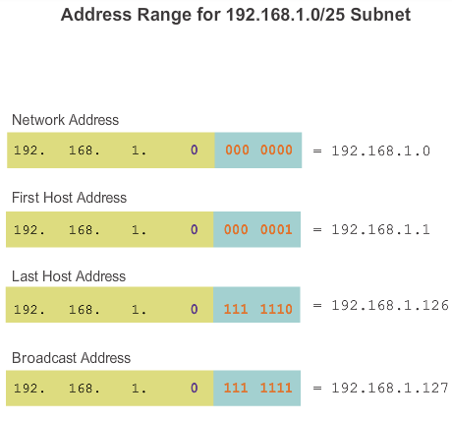
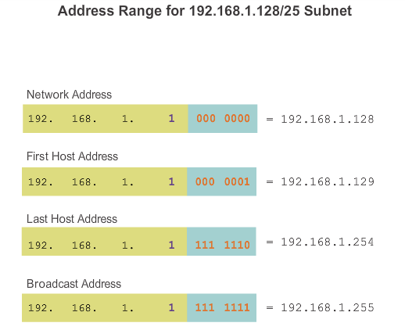
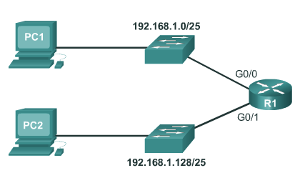
Subnetting in action

Slide 13
Finding the right solution
Determine the number of networks
Determine the number of hosts/network
Do the maths!

Slide 14
Finding the right solution
A.B.C.D/m network, borrow n bits
2^n subnets
2^(32-m-n) addresses/subnet
(2^(32-m-n) – 2) usable hosts
141.163.0.0/16, borrow 7 bits
m=16, n=7
2^7 = 128 subnets
2^(32-7-16) = 2^9 = 512 addresses/subnet
2^(32-7-16) = 2^9-2 = 510 hosts/subnet

Slide 15
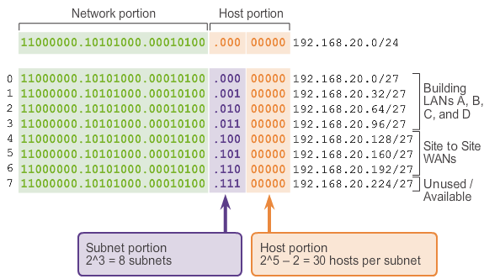
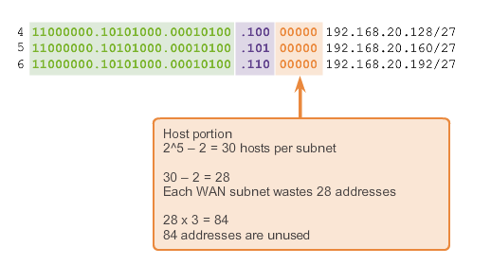
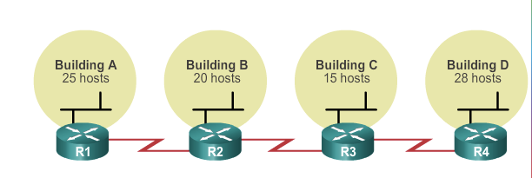
Variable Length Subnet Masking
Why? To reduce wastage

Slide 16
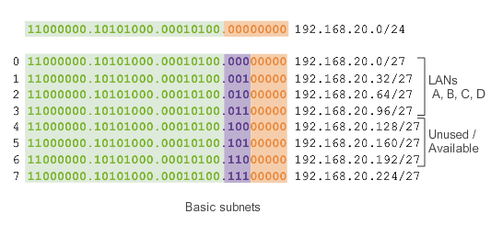
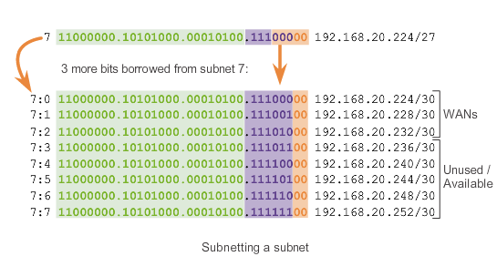
VLSM

Slide 17
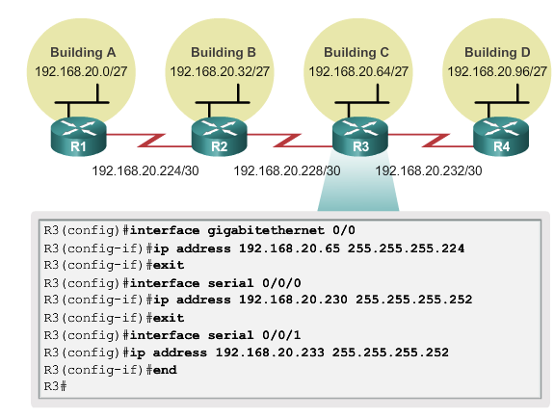
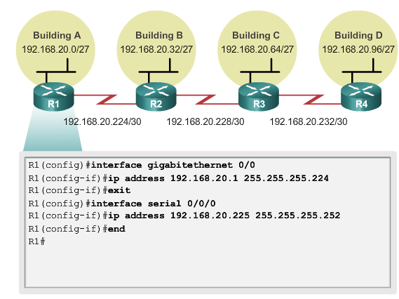
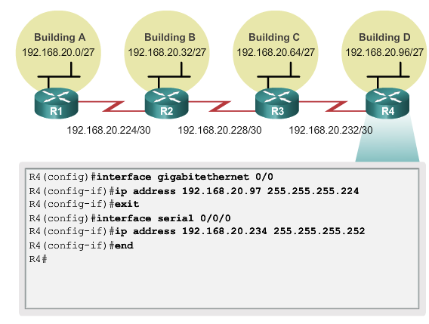
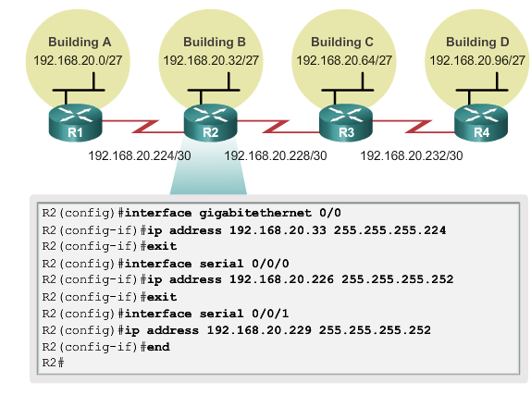
VLSM - implementation

Slide 18
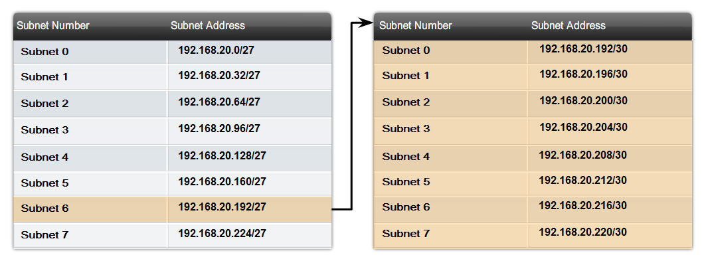
(sub)subnetting

Slide 19
Subnetting Example
Class C address is granted, e.g., 192.168.1.0 (with a total of 256 IP addresses allocatable).
Requirements:
3 networks with 60 hosts
2 networks with 20 hosts
Subnetting
If borrow 2 bits, it will have 4 subnets, each with 2^(6) – 2 = 64 – 2 = 62 hosts
If borrow 3 bits, it will have 8 subnets, each with 2^(5) – 2 = 32 – 2 = 30 hosts
First borrow 2 bits, to have 4 subnets, A, B, C D, each can have 62 hosts. Then from subnet D, further borrow 1 bit, to have two further subnets, each having 30 hosts (e.g. D1, D2).
Can you work out host IP address range, network address and netmask for each subnet (A, B, C, D1 and D2)?
D2
D1
A
C
B
Notes:
Netmask for A/B/C: 255.255.255.192
Netmask for D1/D2: 255.255.255.224
Network address for A: 192.168.1.0
Network address for B: 192.168.1.64
Network address for C: 192.168.1.128
Network address for D1: 192.168.1.192
Network address for D2: 192.168.1.224

Slide 20
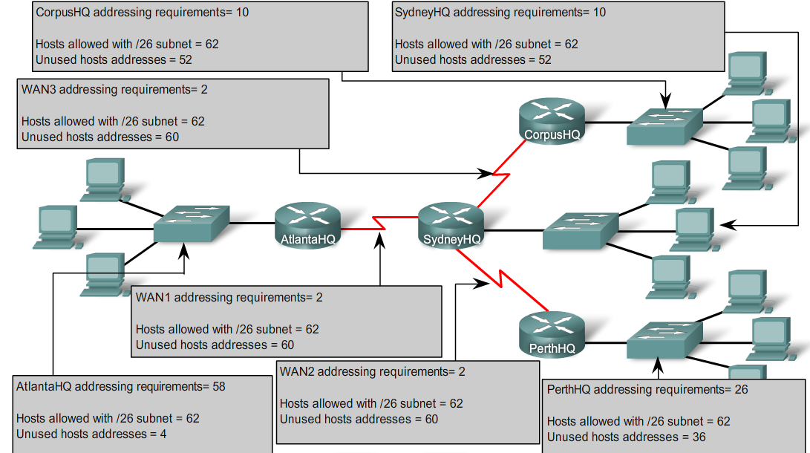
VLSM

Slide 21
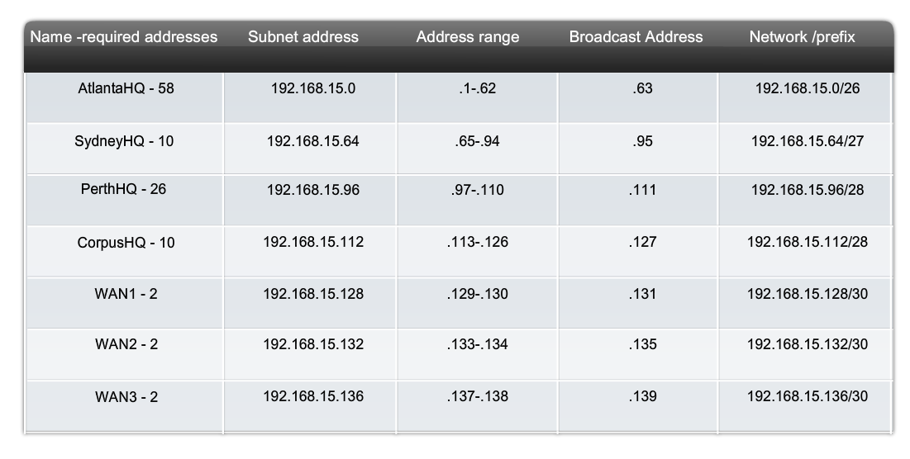
VLSM
PerthHQ - 26
SydneyHQ - 10

Slide 22
IPv4 address planning and assignment
Aims
Preventing Duplication of Addresses
Providing and Controlling Access
Monitoring Security and Performance
Categories of hosts
End user clients - DHCP
Servers and peripherals - static
Hosts accessible from the Internet – static, public
Intermediary devices – static, predictable
Gateway – static, first or last
Notes:
Intermediary devices – these devices are assigned addresses for network management, monitoring, and security.

Slide 23
Activities and labs
11.9.3 – VLSM design and implementation practice
11.10.1 – Design and Implement VLSM addressing scheme
11.8.6 – VLSM practice

Slide 24
Part 2: IPv6

Slide 25
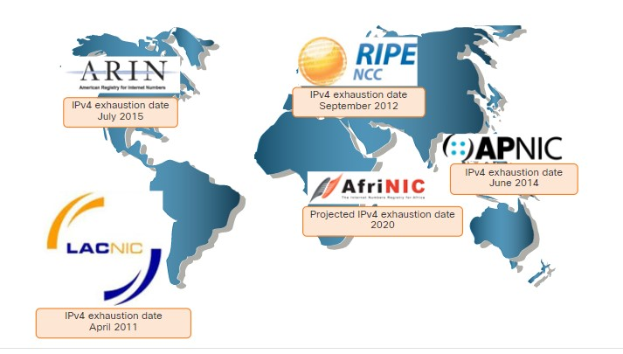
IPv4 is running out
Source: cisco

Slide 26
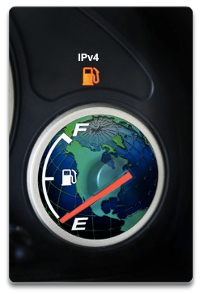
IPv6
Why?
Because IPv4 ran out
What
More addresses
128 bits
No more NAT
Smaller header
Better security
Natively integrated in header functionality

Slide 27
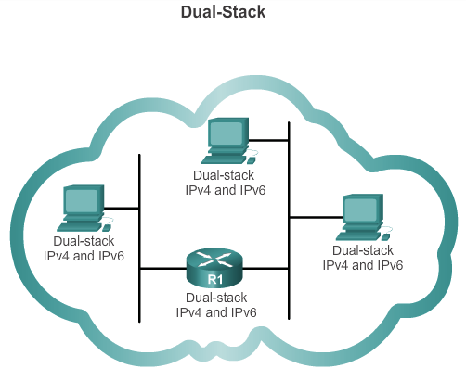
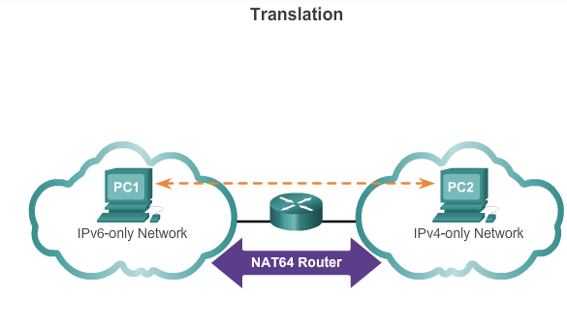
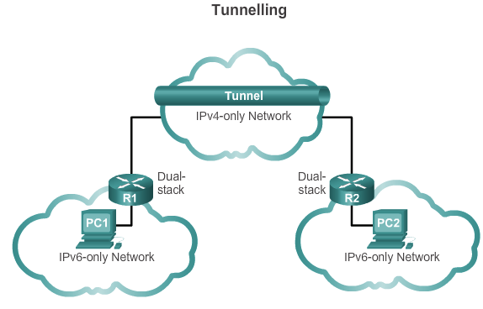
IPv6 – IPv4 coexistence

Slide 28
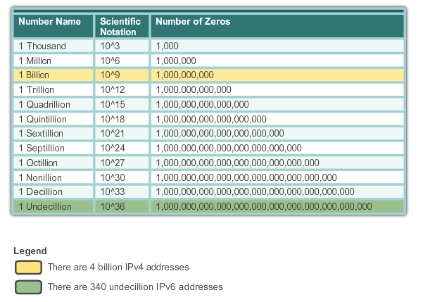
IPv4 vs IPv6

Slide 29
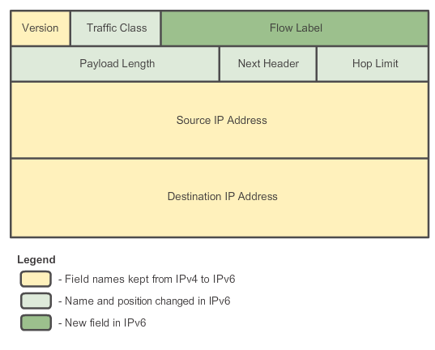
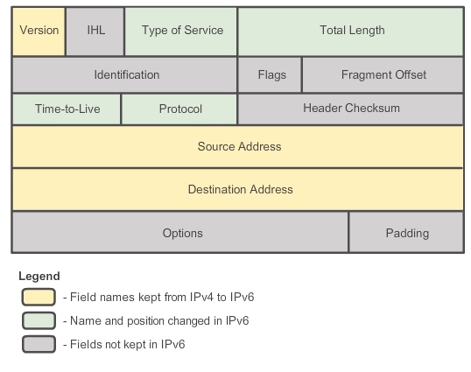
IPv4 vs IPv6

Slide 30
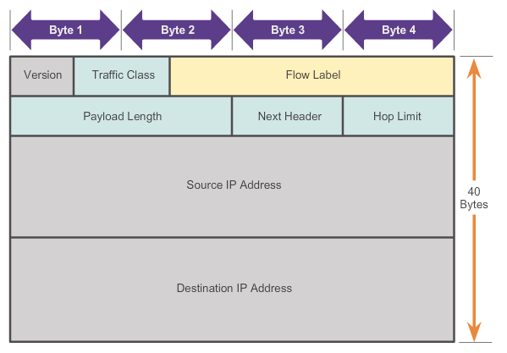
IPv6
Version - 4-bit, set to 0110.
Traffic Class - 8-bit
Equivalent to the IPv4 Differentiated Services (DS) field
6-bit Differentiated Services Code Point (DSCP) - classify packets
2-bit Explicit Congestion Notification (ECN) - traffic congestion control.
Flow Label - 20-bit field for real-time applications
Inform switches and routers to maintain same path for flow
Payload Length - 16-bit, equivalent to IPv4 Total Length
Entire packet (fragment) size, including header and optional extensions.
Next Header - 8-bit field is equivalent to the IPv4 Protocol field.
Hop Limit - 8-bit field replaces the IPv4 TTL field.
Source Address - 128-bit - IPv6 address of sending host.
Destination Address - 128-bit field - IPv6 address of receiving host.

Slide 31
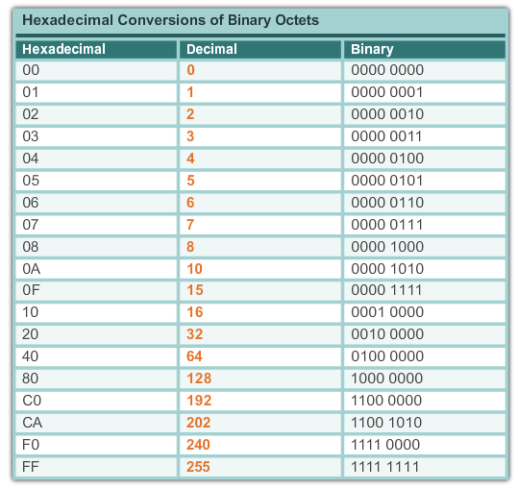
IPv6 representation – hex notation

Slide 32
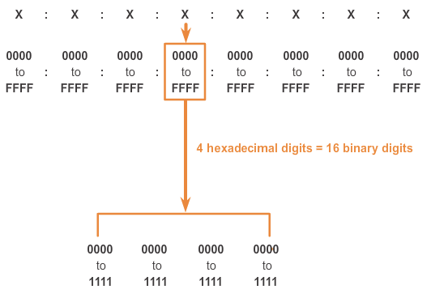
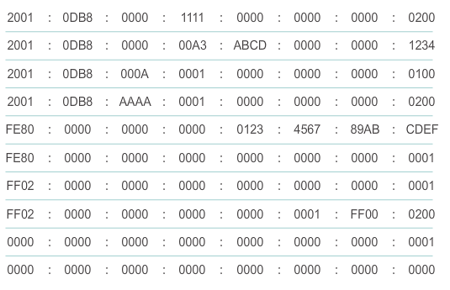
IPv6 representation – hextets

Slide 33
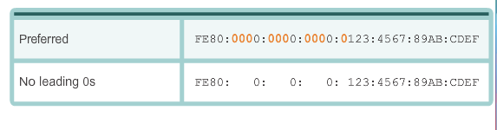
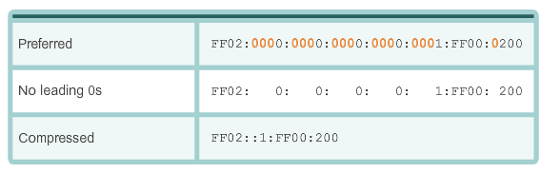
IPv6 representation – omitting 0s
Leading 0s in hextets can be omitted
NOT trailing 0s !
All-zero hextets can be replaced by double colon
Only once in an address

Slide 34
IPv6 communication
Unicast – identify an IPv6 interface
Multicast – send IPv6 packets to multiple destination
Anycast – unicast address that can be assigned to multiple devices
Packet routed to nearest such device
No broadcast address
Replaced by an IPv6 all-nodes multicast (same)

Slide 35
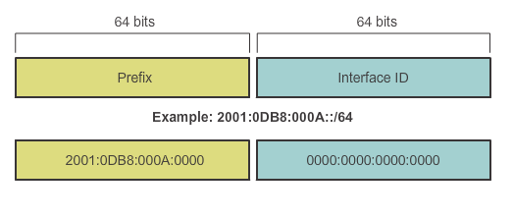
IPv6 networks
Typical prefix - /64

Slide 36
IPv6 addresses
Global unicast – same as IPv4 public – not strictly required
Link-local – for link communication – every IPv6 host is required to have one, automatically created
FE80::/10
Not routable
Unique local – similar to RFC1918 IPv4
FC00::/7 to FDFF::/7
Not routable
Loopback
All-zero except the last bit
::1
Unspecified – use as source when n IPv6 assigned
All-zero
::

Slide 37
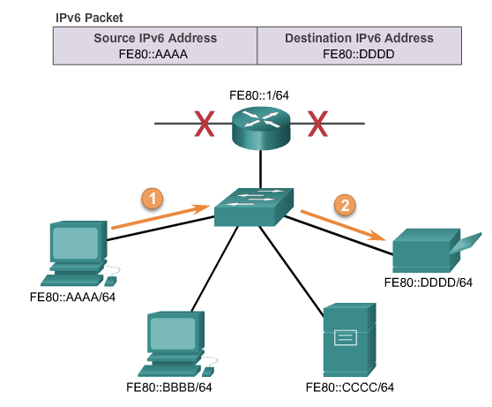
IP link-local communication

Slide 38
IPv6 global unicast addresses
Three parts
Global routing prefix (aka network portion)
assigned by ISP, typically /48
Subnet ID
Used by organisation to identify subnets
Interface ID (aka host portion)

Slide 39
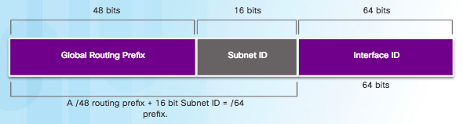
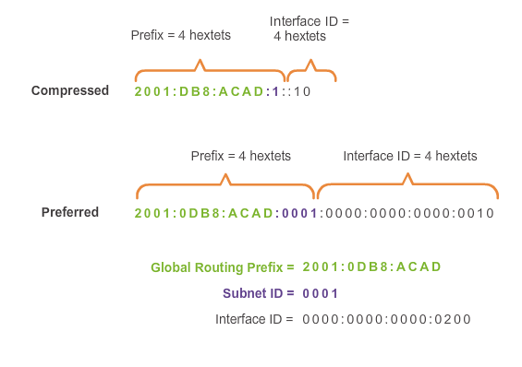
IPv6 global unicast address – example

Slide 40
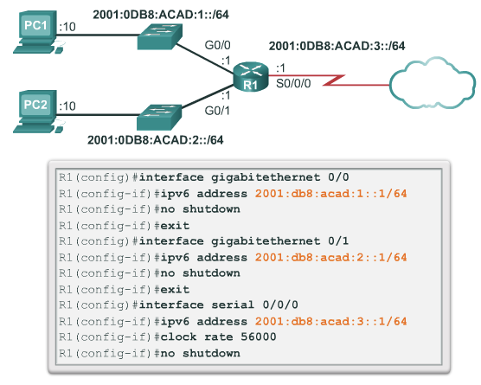
IPv6 address - router configuration

Slide 41
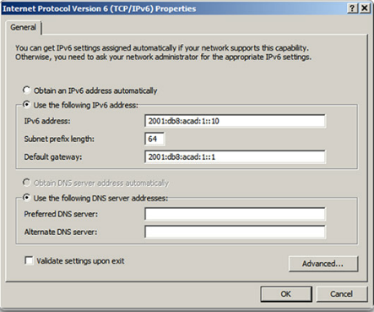
IPv6 address – host configuration

Slide 42
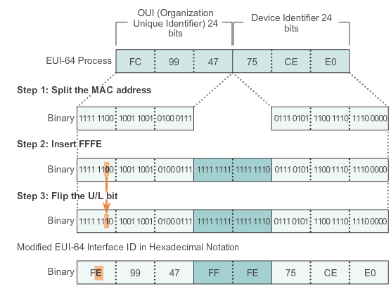
EUI-64 – the process

Slide 43
EUI-64 – the process
MAC address
24bit OUI
24bit device identifier
EUI-64 interface ID is made of three parts:
24-bit OUI from the client MAC address, but the 7th bit (the Universally/Locally (U/L) bit) is reversed - if the 7th bit is a 0 it becomes a 1, and vice versa.
The inserted 16-bit value FFFE (in hexadecimal)
24-bit Device Identifier from the client MAC address

Slide 44
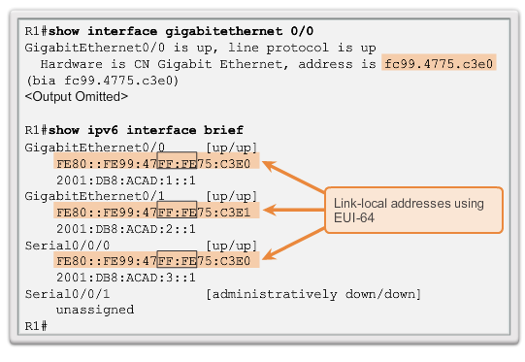
EUI-64 – the result

Slide 45
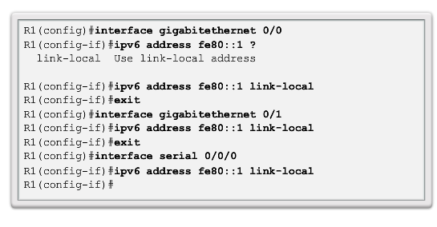
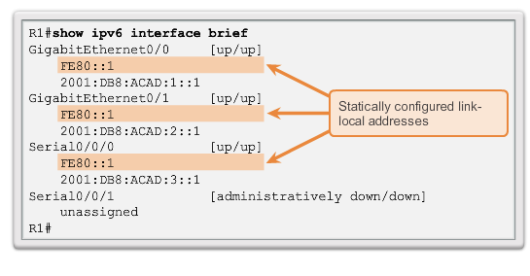
Static link-local addresses
Router(config-if)#ipv6 address link-local-address link-local

Slide 46
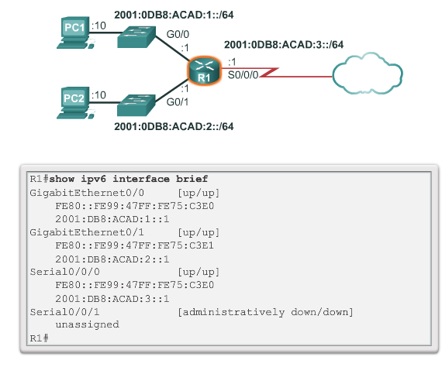
Verify IPv6 configuration

Slide 47
IPv6 subnetting
No need to save IP address space
Wastage is irrelevant for 2¹²⁸ addresses
Implemented for hierarchical reasons
Same as other-than-wastage IPv4 reasons

Slide 48
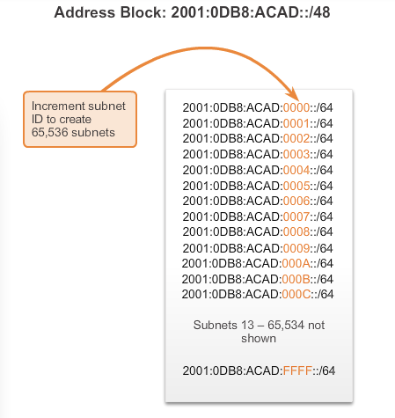
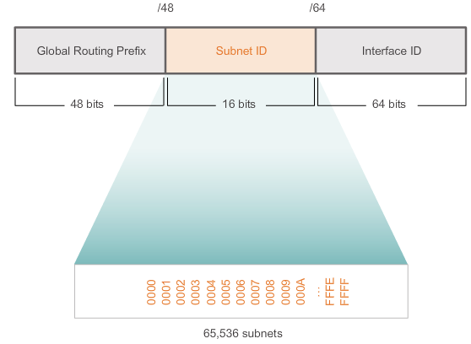
IPv6 subnetting - /48 block

Slide 49
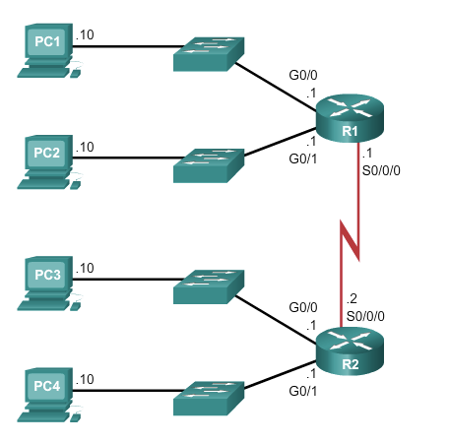



IPv6 subnetting example

Slide 50
Labs
12.9.1 – Implement a subnetted IPv6 addressing scheme (optional)

